Slide 1
Chat bots
FOSSASIA 2016
Dan Tran

Slide 2
IRC bots
Those were the days…
Notes:
Curate our news, schedule our days, take care of our customer service issues, find, schedule and pay plumbers.
Replace most stand alone mobile apps, disrupt search, bring true context to marketing, improve workplace and personal life efficiency, and open the door for new digital tycoons

Slide 3
Platform
Slack
Telegram
Opensource: Mattermost, Rocket.Chat,

Slide 4
Bot-as-a-service
Connect with Platform via token
No traditional web-based HTML/CSS
Not need to be fast
Much easier to scale
Mistakes Are Not So Visible
Easy to Integrate With Other Services
Notes:
http://www.yegor256.com/2015/11/03/chatbot-better-than-ui-for-microservice.html

Slide 5
Use cases

Slide 6
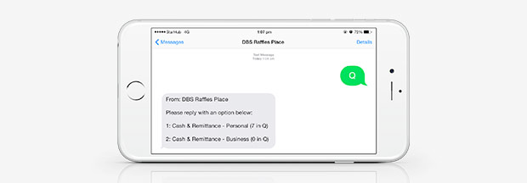
Banking
Notes:
https://markbeccue.wordpress.com/2016/02/
Build conversational AI for applications.
Empowers consumers to engage anytime
Consumers desire contextual and highly personal engagement.

Slide 7
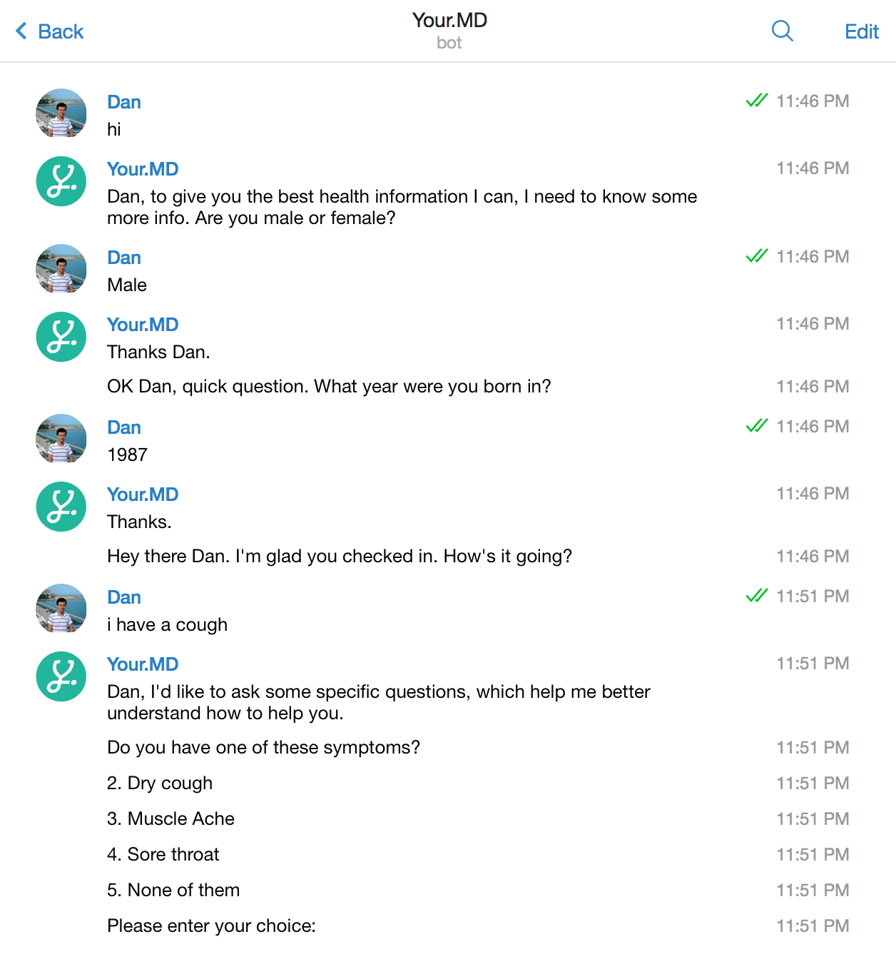
Healthcare

Slide 8
Transportation
/grab [Start] [End]
/book [taxi/grabcar/helicopter] [Start] [End]
/receipts [booking code]

Slide 9
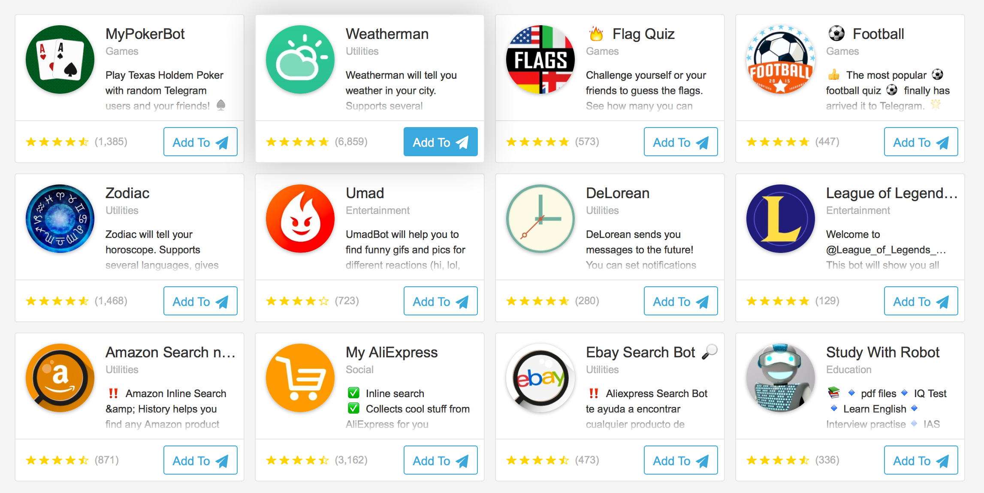
Others
Screen Shot 2016-03-19 at 9.00.16 am

Slide 10
Slack
Setup business meeting
Continuous Integration Development(Github…)
Poll, Reminder…
Notes:
https://medium.com/inside-birdly/190-resources-to-power-up-your-slack-fdf339786fdb#.omnuq9ed3
https://markbeccue.wordpress.com/2015/12/

Slide 11

Telegram
- Encryption messages
- Bot Service API
- Customize keyboards
- Channel, Inline bots…

Slide 12
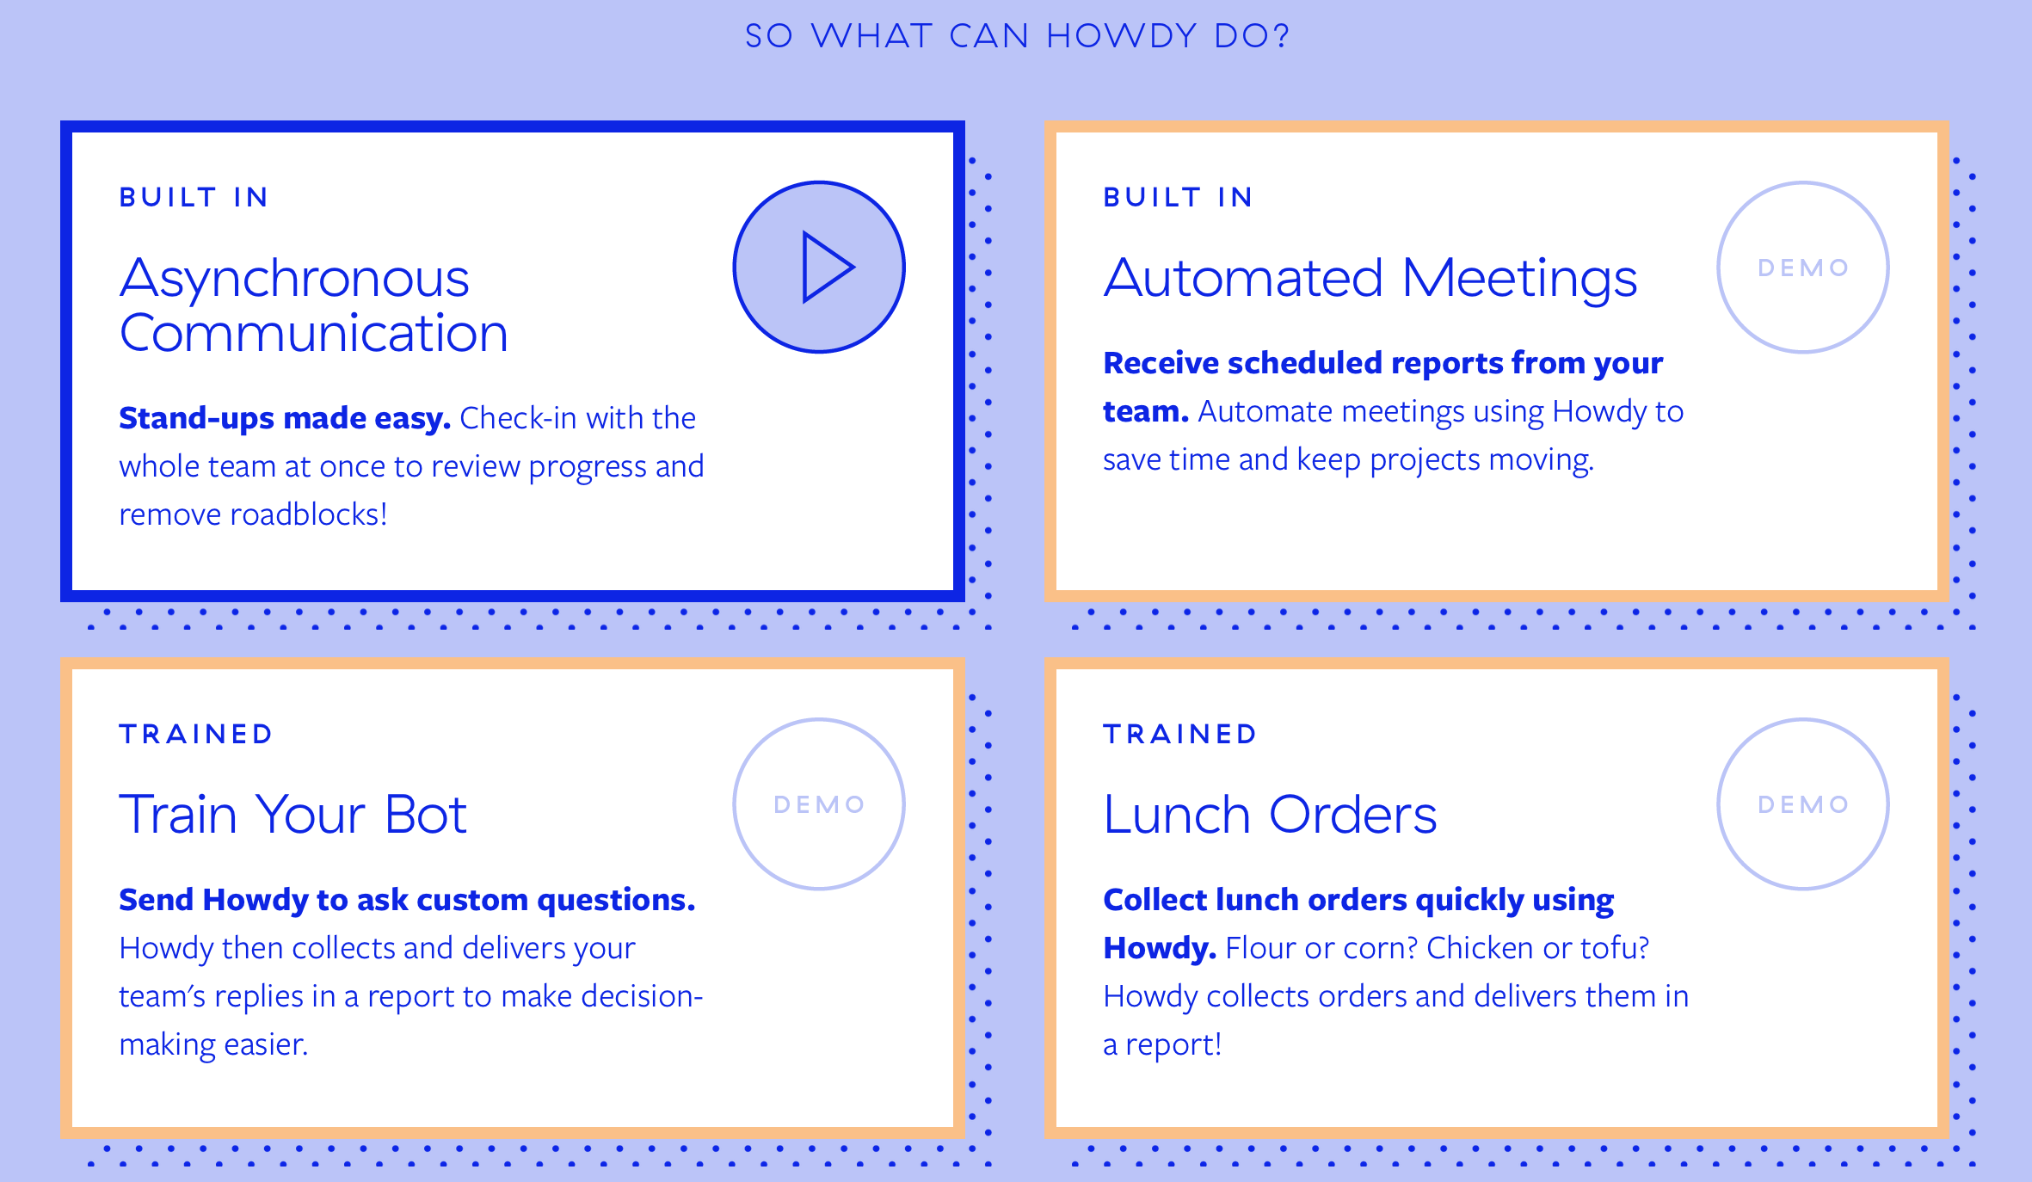
Automated Bot

Slide 13

AI Bots

Slide 14
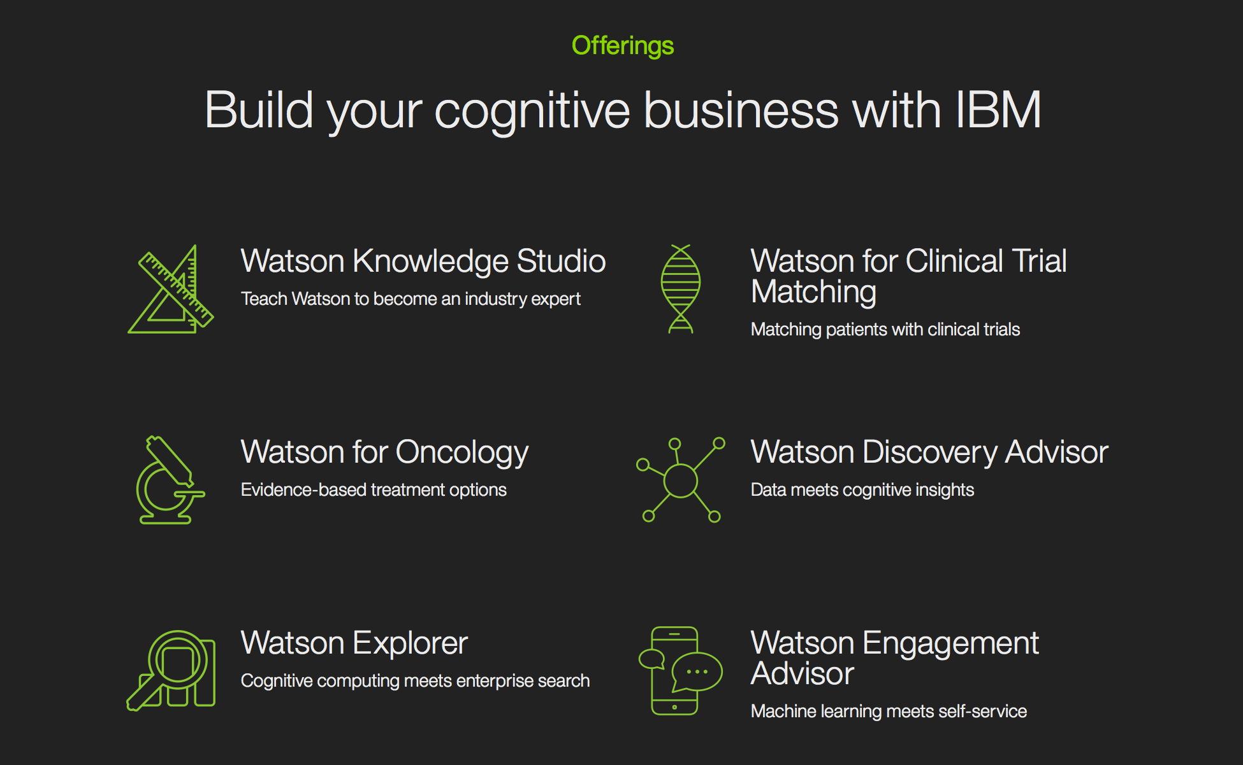

Slide 15

How to connect with Bot service
Polling
Telegram Server
Your computer
limit<=100
Messages request
Message
Users
Polling:
/getUpdates?offset=*&limit=*

Slide 16
Telegram Server
Response
Your computer
Response
Response
Text:*
ForceReply: *
KeyboardMarkup:*
Users

Slide 17
Thank you
Twitter: @trongdan_tran

